Slide 1
Requirements
DNS
Email server
Message Parser
Network
IR transmitter
X-10
Insteon
Integration
Technologies
Wi-Fi
Bluetooth
Z-Wave
ZigBee

Slide 2
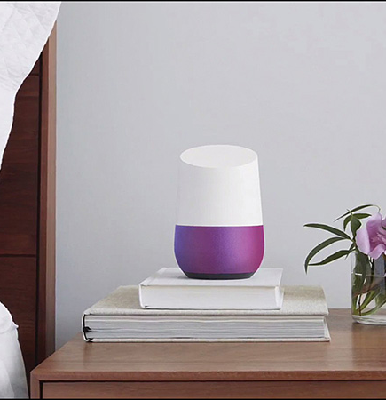
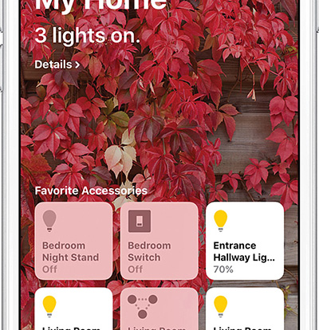

Smart home controllers

